Slide 1
Maintenance and Administration
Configuration and Patches Management
UNIT - 5

Slide 2
Configuration Management
Configuration change management processes may include:
Identification and documentation of changes.
Justification/Rationale
Assessment of the potential impact of changes, including security implications, and criticality.
Identification of a change control authority, which may be vested in either individuals or groups as appropriate.
Documented review and approval by the designated change control authority.

Slide 3
Communication of significant changes and their planned schedule to stakeholders using a standard template.
Identification of schedules and timelines for changes.
Rollback/contingency plan.
Testing procedures to ensure the change is functioning as intended.
Communication of completed change details to stakeholders using a standard template.
Updating of all appropriate system documentation upon the completion of a significant change.

Slide 4
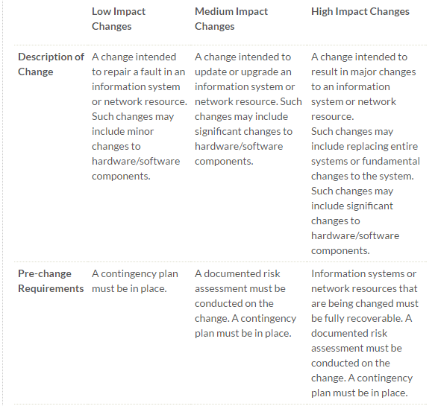

Slide 5
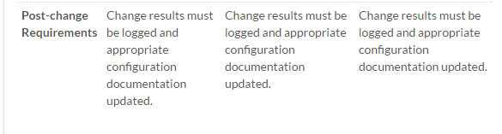

Slide 6
Sample change management request form (RFC)
Change Request Title * (note in subject if urgent)
Description: *
Servers/Services/Systems Affected:*
Upstream/downstream servers/services/applications affected (e.g., e-mail not available during upgrade, HRMS unavailable or a specific machine will be unavailable):*
Justification/Rationale:*
Proposed Start Date and Time:*
Expected Outcomes:*

Slide 7
Related Changes: Other system or services changes related to this change, also note any dependencies which must occur before this change, or any changes which require this change before they can be completed
Stakeholder Communication: Who will be contacted, by whom and how. (e.g., Helpdesk + Students + Staff, ITS, CCCC, All MPPs)
Test plan:*
Rollback/Contingency Plan: Include possible visible outcomes and potential impacts. Also include when the rollback would occur and its duration

Slide 8
Patch Management
An inventory of all servers should be maintained indicating the operating system version, directly or indirectly-exposed applications which present a potential risk of security exploitation, the current patch level of critical components and designated administrators.

Slide 9
Patch management standards and procedures may include:
A timeline for applying (or deciding not to apply) patches for network-connected devices.
A procedure to address exceptions for not installing or for removing security patches. Such patch application decisions must be documented and state reason(s) for not installing or for removing a security patch, and should include appropriate management review and approval.

Slide 10
A rollback procedure to remove patches that interfere with production services.
A post-installation verification to ensure patches are at intended level.
MPP-level approved process for ensuring periodic review and confirmation that patches are updated on a regular basis.

